Slide 1
Durham Open Space Plan and Conservation Strategy
Durham Select Board Meeting
October 28, 2025

Slide 2

Funding through the Community Action Grant
Community Action Grants (CAG) support communities enrolled in the CRP. Activities from the List of Community Actions that align with the state climate action plan require no match!
The Community Resilience Partnership (CRP) offers communities support for both climate mitigation and adaptation activities.
GRANT DETAILS
$80,000​
​
No Match​
​
24 Months​

Slide 3
Purpose and Goals
Establish a townwide strategy for land conservation and preservation
Identify areas prone to flooding and water quality issues
Assess how open spaces and natural resources can provide ecological and community services
Serve as a tool for coordinating projects, policies, programs
Set a strategy to be incorporated into upcoming Comprehensive Plan update
Durham: 3% of land conserved in 2025
Maine Won't Wait = 30% conserved land by 2030

Slide 4
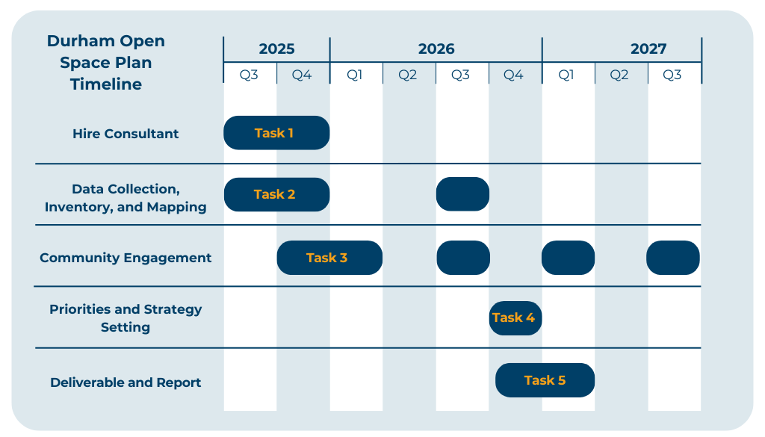

Slide 5
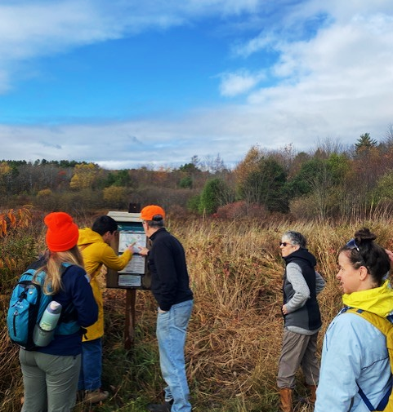


Task 1: Hire Consultant
The Greater Portland Council of Governments (GPCOG) and FB Environmental (FBE) have been selected as consultants
Notes:
Talk about our team – Kelly being on leave, Shannon and I stepping in to manage, and our Fellow and community engagement team support.

Slide 6
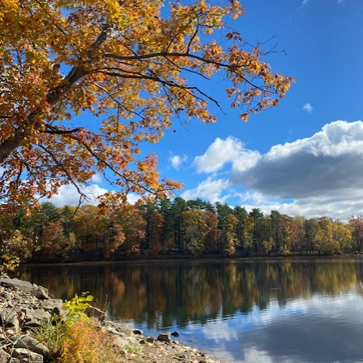
Task 2: Data Collection, Inventory, and Mapping
FBE gathered data to establish baseline conditions
Conduct ground-truthing and gather site-specific data
Vulnerability analysis with climate projection data
Synthesize data into maps, GIS databases, and the comprehensive inventory report

Slide 7
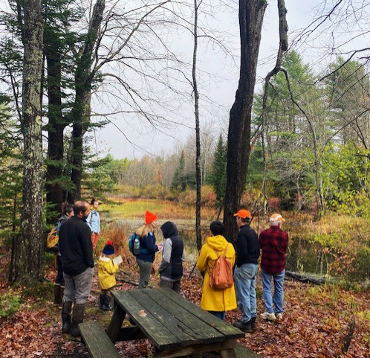
Task 3: Community Engagement
Initial site visits with key stakeholders Oct. 21
Public engagement strategy
  Community survey
  Public workshop
  Outreach and engagement materials
Notes:
Developing a Community Engagement Plan that identifies key stakeholders, establishes approaches for outreach and identifies materials needed. Survey will be a key component of this

Slide 8
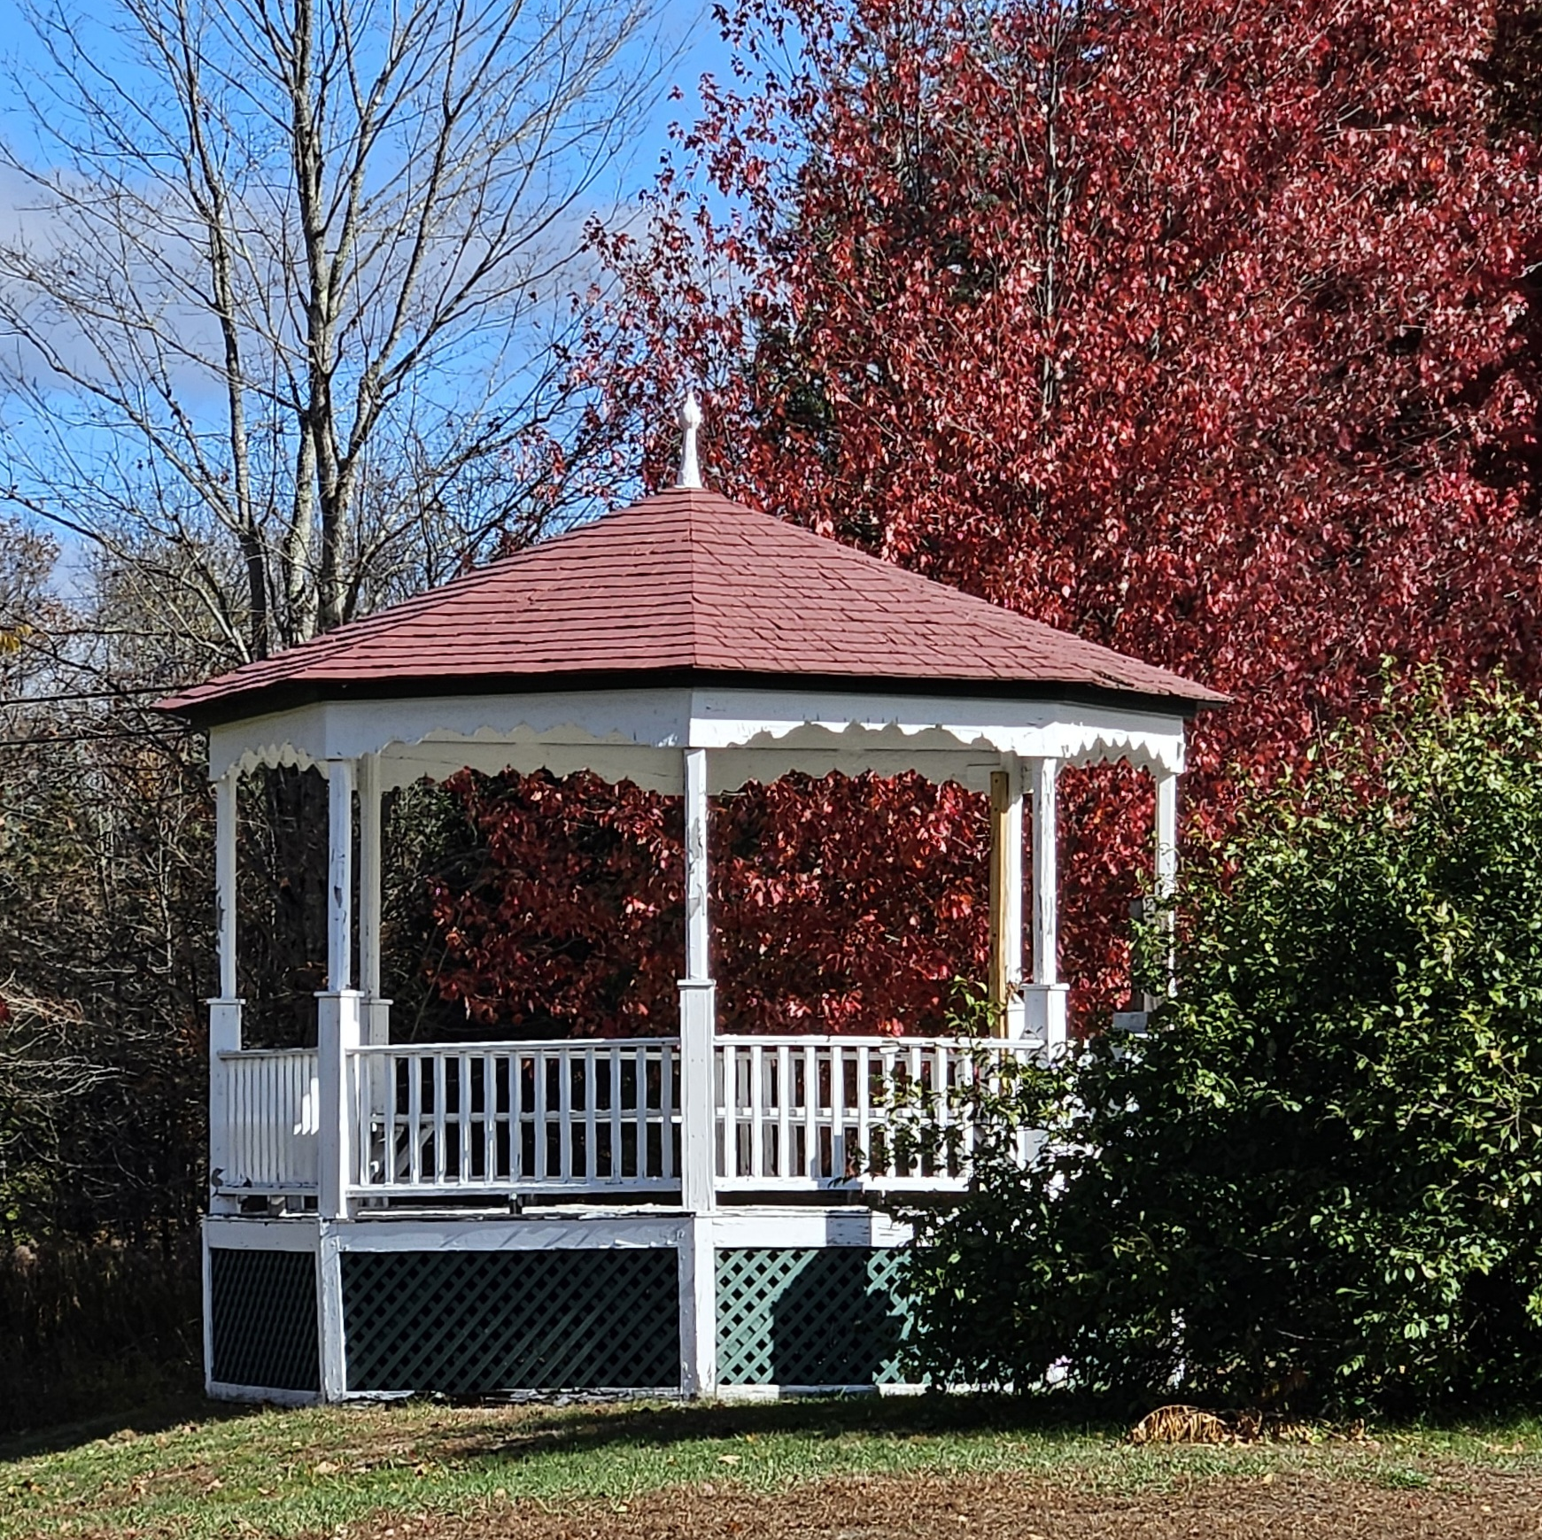
Task 4: Setting Priorities and Strategy
Develop prioritization approach
Identify best strategies
Research funding strategies targeted at strategies
Notes:
Prioritization approach for key areas, Identify best strategies for conservation

Slide 9
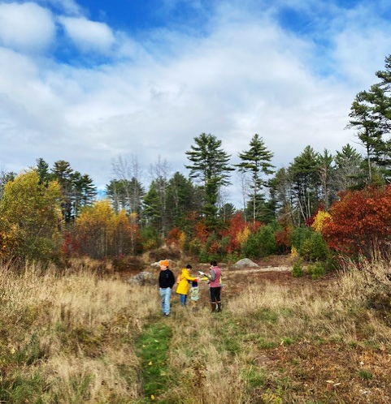
Task 5: Deliverable and Report
The Open Space Plan and Conservation Strategy will serve as both a stand-alone planning document and as a tool for natural resource management and climate resilience strategies
Notes:
Meant to act as a tool for implementation conservation approaches, but will also act as a plan and strategy that can be integrated into other planning processes and set the priorities for the town.

Slide 10
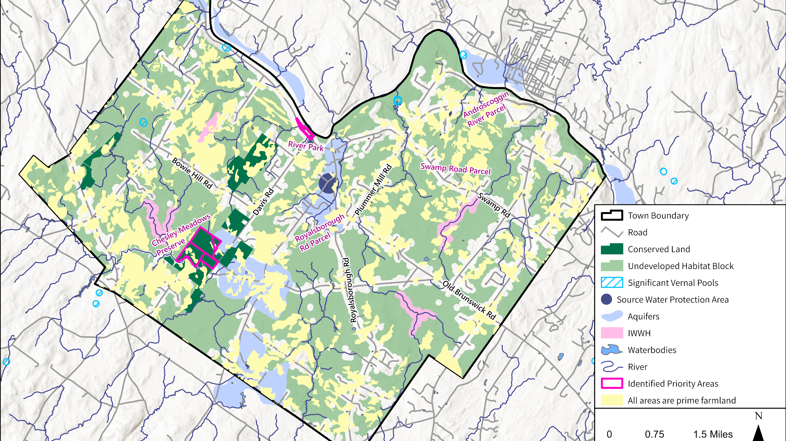
Durham Open Space Plan
Existing Conditions

Slide 11

Existing Conservation Land (~3%, dark green)
Goal of 30% conserved land by 2030 to align with Maine’s statewide goal.
More than 750 acres of conserved land
  Town of Durham
  Royal River Conservation Trust
  Androscoggin Land Trust
  Maine Farmland Trust
  USDA
Concentrated in the western part of town.
Additional open space opportunities on town-owned parcels.

Slide 12
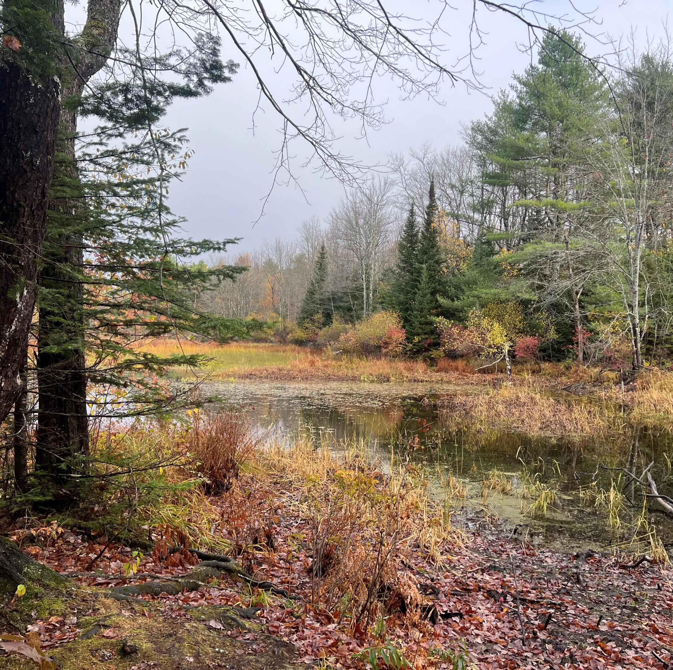
Lakes and Streams
Four main watersheds
  Newell Brook-Androscoggin River
  Chandler Brook
  East Branch Chandler Brook
  Androscoggin River-Merrymeeting Bay
Seven major streams
Runaround Pond is the largest lake (133 acres)
7% of Durham’s lakes and streams are within conserved lands

Slide 13
Wetlands and Water Resources
3,500+ acres of wetlands
  5.1% conserved
1,550+ acres of aquifers
  6% conserved
32 acres well head protection areas
90 acres source water protection areas

Slide 14
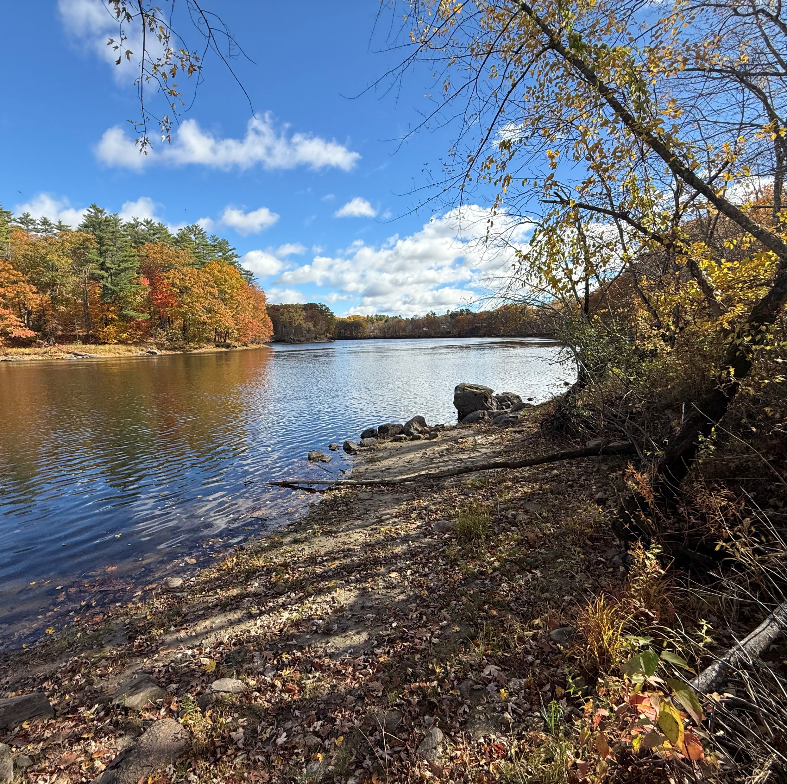
Water Quality
Water quality impairments:
  Chandler River/Brook and East Branch Chandler Brook (low dissolved oxygen)
  Androscoggin River (legacy toxins)
  Runaround Pond (macroinvertebrate assessment nonattainment in 2010)
15 site types of potential water quality concerns. Most common types:
  RCRA small quantity generator
  Resource extraction activity
  Automobile graveyard/junkyard
  Leaking aboveground storage tank
  Why This Matters for Open Space Planning:
  Water quality protection is a core conservation goal. Conserving land along impaired waterways and around contamination sites can prevent further degradation and support natural restoration.
Notes:
Why are we showing you water quality data in an open space plan?
Water quality protection is a primary conservation goal
One of the key reasons to conserve land is to protect water resources-- Conservation easements often include water quality protection provisions
Impaired waters = conservation opportunities
The Chandler Brook system is impaired, which means protecting land along those waterways should be a priority.
Buffer strips of conserved land along streams act as natural filters.
Conserving floodplains and wetlands reduces pollution runoff.
Runaround Pond is a regional asset worth protecting
Durham's largest lake (133 acres) has had water quality concerns in the past.
Protecting the watershed around Runaround Pond should be a conservation priority.
Already have some conserved land around it - opportunity to expand.
Legacy contamination sites need careful consideration
These 15 documented sites represent decades of varied land uses.
Not all conserved land is suitable for public recreation
Some contaminated sites might be good candidates for conservation without recreation access
Conserving them prevents problematic redevelopment and allows natural recovery
Water quality connects to other goals
Clean water supports the wildlife habitats
Critical for the agricultural community (irrigation, livestock).
Clean aquifers = safe drinking water for residents (most homes on wells).
Climate resilience - healthy wetlands and streams handle flooding better.

Slide 15
Wildlife Habitats
Some of the most undeveloped habitat blocks in southern Maine
  7 larger than 1,000 acres
  14 between 100 and 1,000 acres
Habitat for endangered, rare, threatened, and species of special concern
  Blanding’s turtle
  Bald eagle
  Creeper mussel
  Dry land sedge
  Needletip blue-eyed grass
  Narrow-leaved arrowhead
53 acres of inland waterfowl and wading bird habitat
5 (mapped) vernal pools

Slide 16
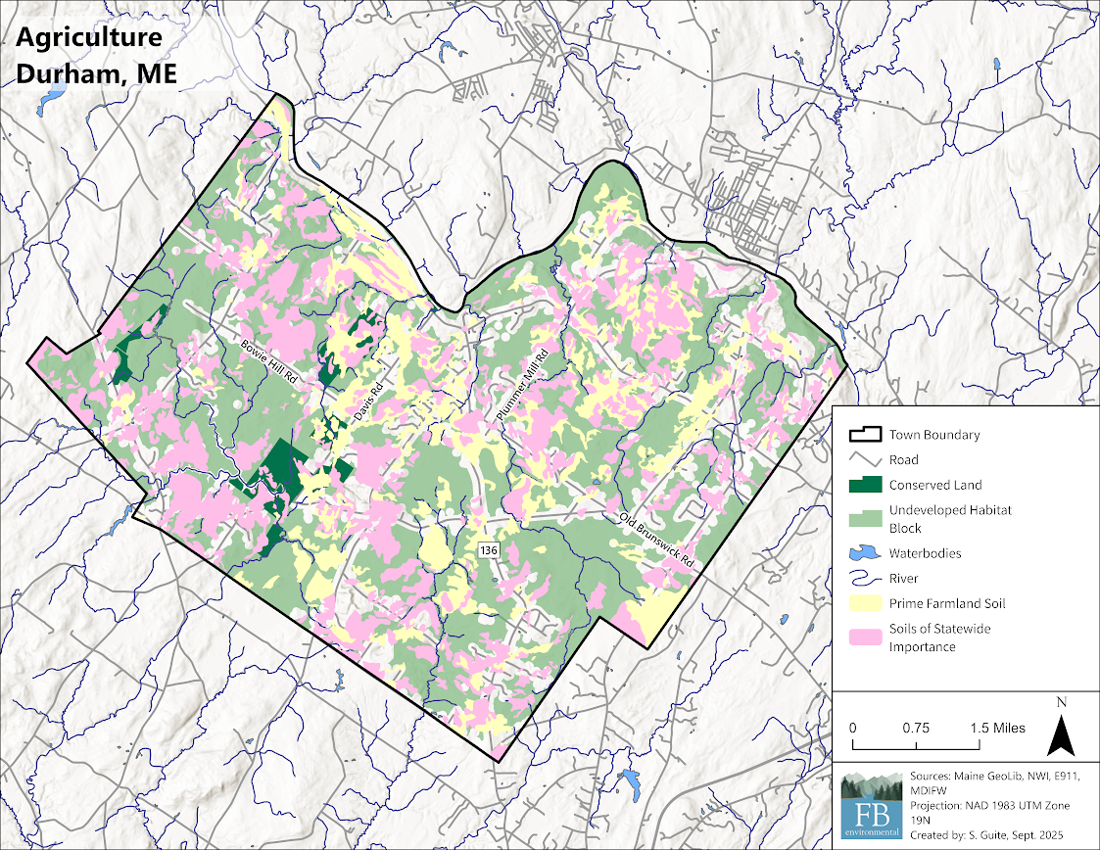
Agriculture
  Prime Farmland:
  Land that has the best combination of physical and chemical characteristics to economically produce sustained high yields of crops when managed and is available for these uses (i.e., not urban developed or water).
418 acres in Maine Farmland Program
3,300+ acres of prime farmland soils (13.5%)
5,700+ acres of farmland of statewide importance (23.1%)
3,670 acres of timber harvesting
  2,412 in Maine Tree Growth tax program
At least four farms protected by conservation easements
  Soils of Statewide Importance:
  Those that are nearly prime farmland and can still economically produce high yields of crops when managed.
Notes:
https://www.maine.gov/dacf/ard/resources/docs/prime-farmland-determination-guidelines-v6.pdf
How to Determine if a Soil is Prime Farmland:
The depth to groundwater table must be deep enough during the cropping season to allow cultivated crops common to the area to be grown (24” or deeper has been chosen to meet this criteria). The soil can also be drained and qualify if the ground water table is a at depth of less than 24”.
To qualify as prime farmland, there can’t be enough stones to interfere with farming.
You do need to determine the erodibility of the soil by looking up the K factor and multiplying it by the slope. In order for the soil to be prime farmland, the product of that multiplication has to be less than 2.0.
You do need to determine whether or not the soil floods less often than once in every 2 years, required in order to be prime farmland. v.7.22.20 3
You do need to determine the permeability rate of the soil which must be equal to or more than 0.06 inches per hour in the upper 20”. Base this decision on the presence or absence of a “root restrictive layer” including hardpan or bedrock. Layers above a root restrictive layer will have a permeability of 0.06” per hour or more. Layers below a hardpan or bedrock will not have adequate permeability.
You do need to determine the percent of the surface layer (upper 6”) that is coarse fragments over 3”. It must be less than 10% in order to qualify as a prime farmland.
You may need to determine an adequate and dependable water supply from precipitation or irrigation. Soils that are somewhat excessively or excessively drained would not qualify as prime farmlands unless irrigated.
How to Determine if a Soil is of Statewide Importance:
Does not meet Prime Farmland criteria.
Does not have a seasonal groundwater table within 16 inches of the mineral soil surface during the growing season of most years (moderately well or well drained).
Are less than 15% slope.
Have less than 3% cover of rocks or stones greater than 10 inches in diameter and less than 40 % cover of rocks less than 10 inches but more than 2” in diameter.
Are more than 20 inches to a root restrictive layer (hardpan or bedrock)
Have greater than 2 inches of available water holding capacity in the upper 20 inches of soil (loamy fine sand or finer).
NRCS further requires areas designated as of statewide importance to be composed of at least 50% coverage of soils meeting the criteria. That means small areas of soils meeting the criteria scattered about a site do not have to be added up as they would not be realistically farmable (similar to pit and mound topography in wetland determinations where you use what predominates).

Slide 17

Climate Vulnerability
2024 Androscoggin County Hazard Mitigation Plan Durham vulnerabilities
Road Name | Agricultural Impacts from Drought | Wildfire | Flash Floods | Severe Summer Weather | Severe Winter Weather
Bowie Hill Road
Davis Road
Old Brunswick Road
Pinkham Brook Road
Newell Brook Road
Swamp Road
Stackpole Road
Royalsborough Road

Slide 18
Conservation Mechanisms
Fee acquisition
  Town ownership of a property
  Expensive, but full control
  Does not provide permanent conservation on its own
  .
Conservation easements
  In partnership with land trusts
  More cost-effective
  Offers permanent conservation
  .
Agricultural easements
  Maine Farmland Trust partnership
  Offers permanent conservation, often with
  maintaining active farmland as a condition
  .
Deed restrictions
  Similar to conservation easements, but conditions may vary
  .
Current partners
  Royal River Conservation Trust
  Androscoggin Land Trust
  Maine Farmland Trust
Purposes and land uses may vary!
Wildlife habitat protection
Recreation
Maintain active farmland
Allow select timber harvests
Allow limited development
Prohibit all development
Prohibit intensive development (extractions, etc.)
Some conservation methods may not include public access

Slide 19
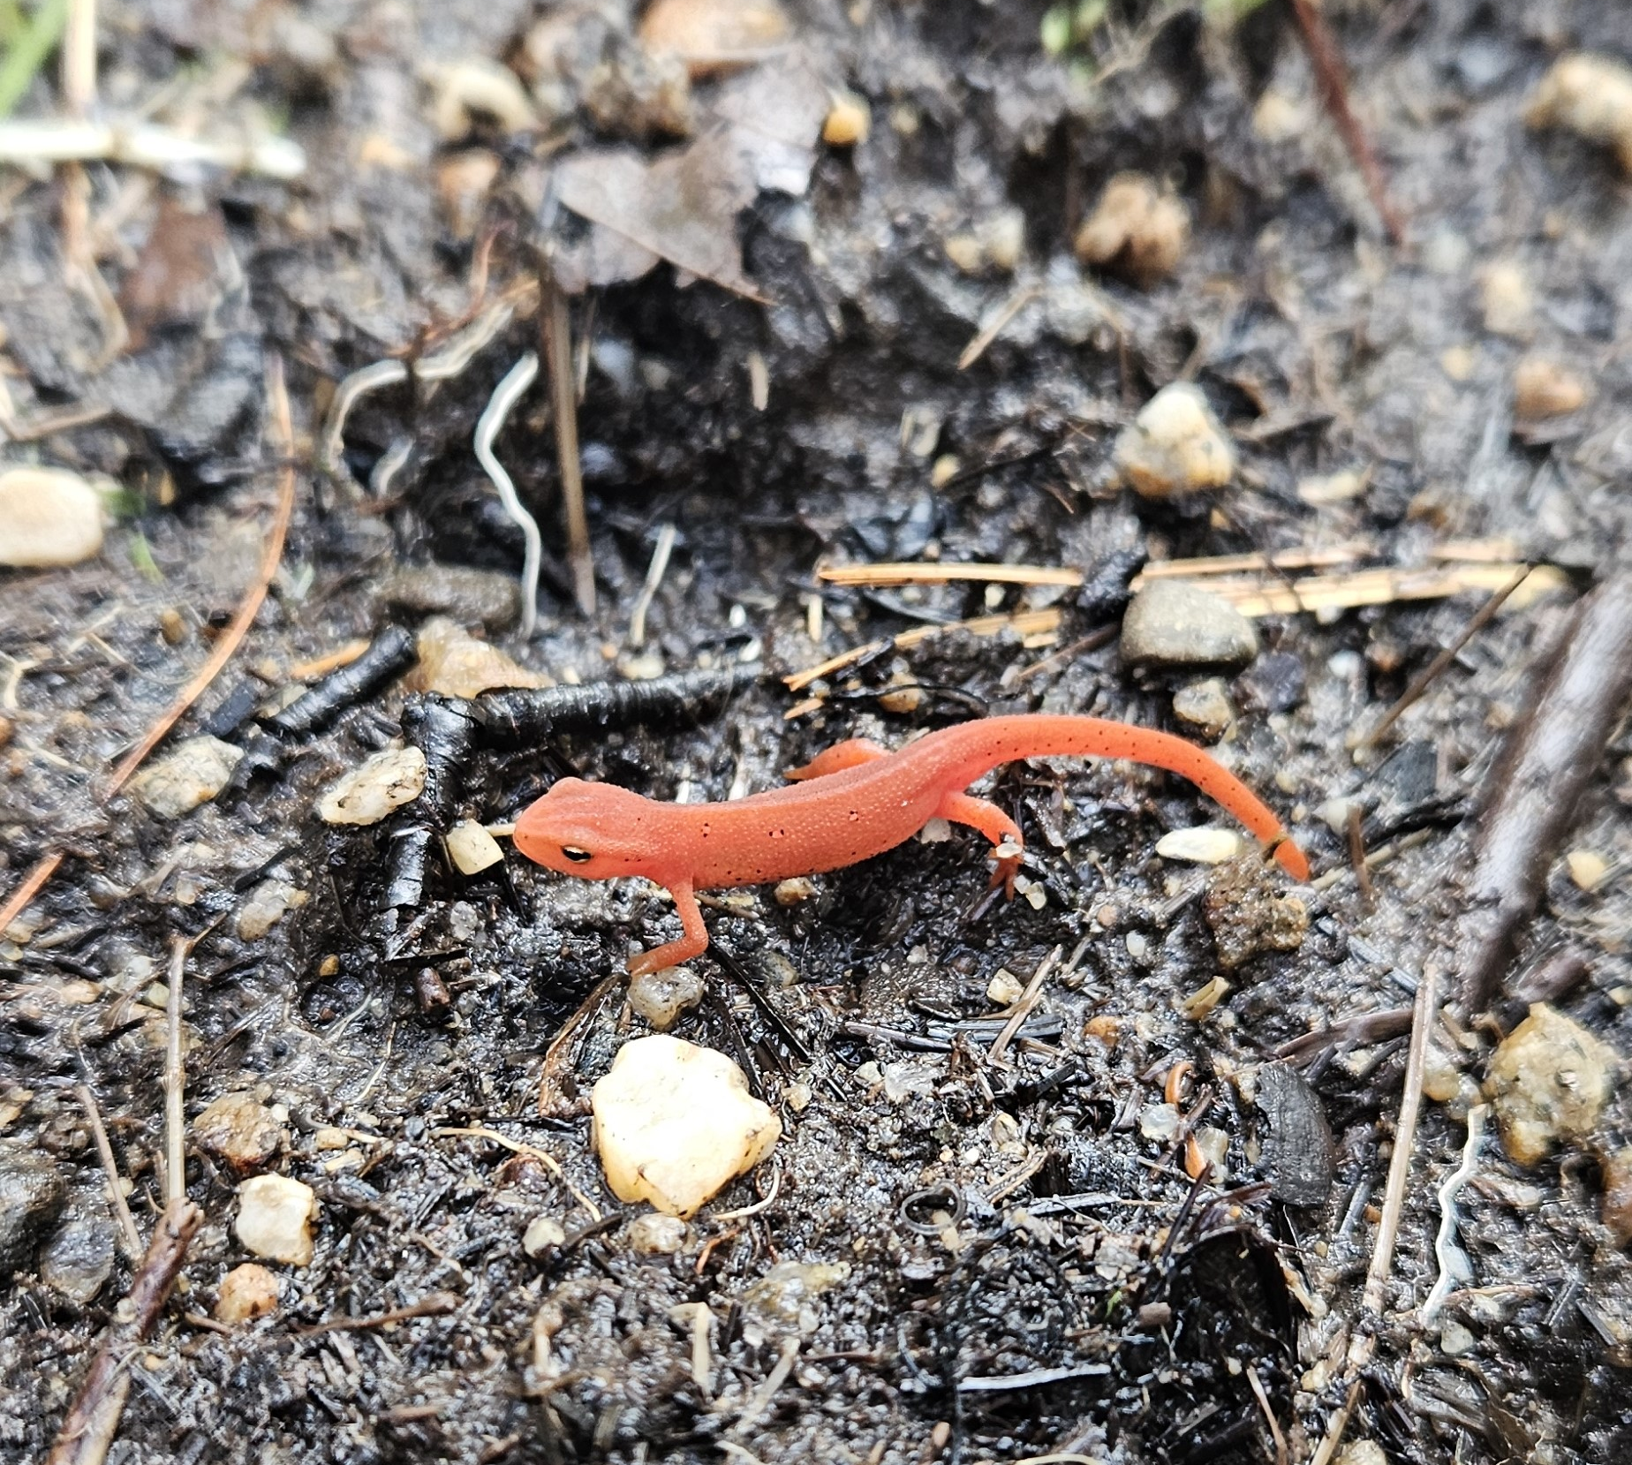
Feedback or Questions?

